Slide 1
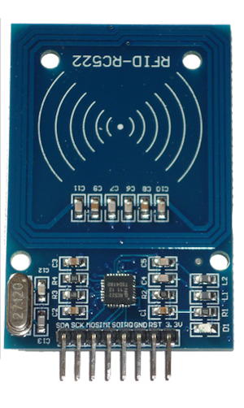
MFRC522

Slide 2
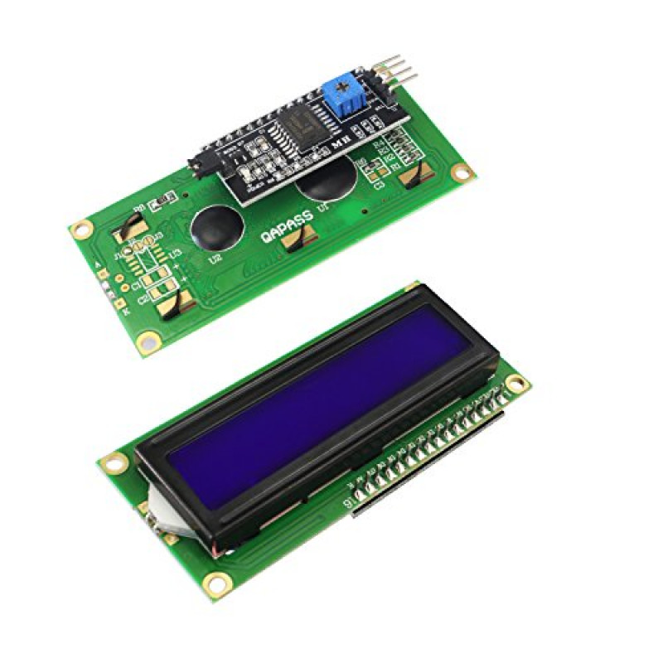
LCD I2C 16x2

Slide 3
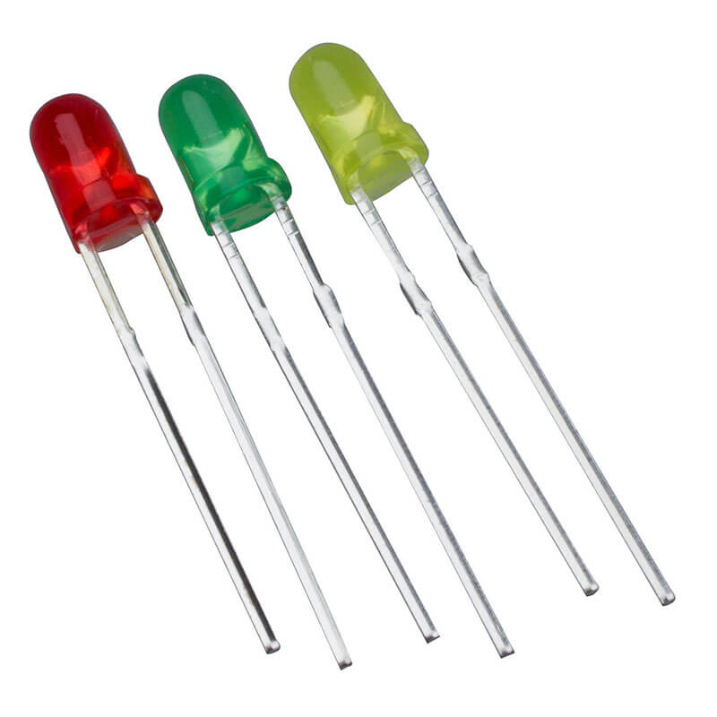
LED

Slide 4
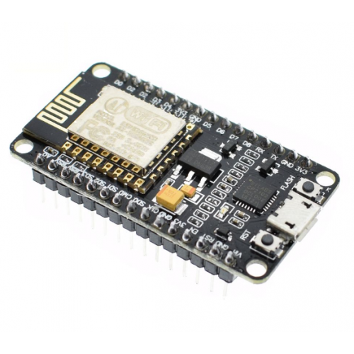
NodeMCU/ESP8266

Slide 5
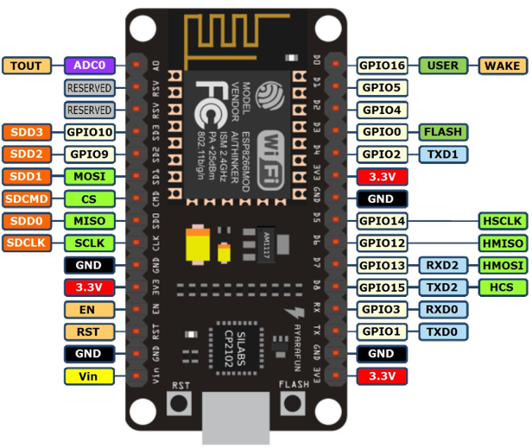
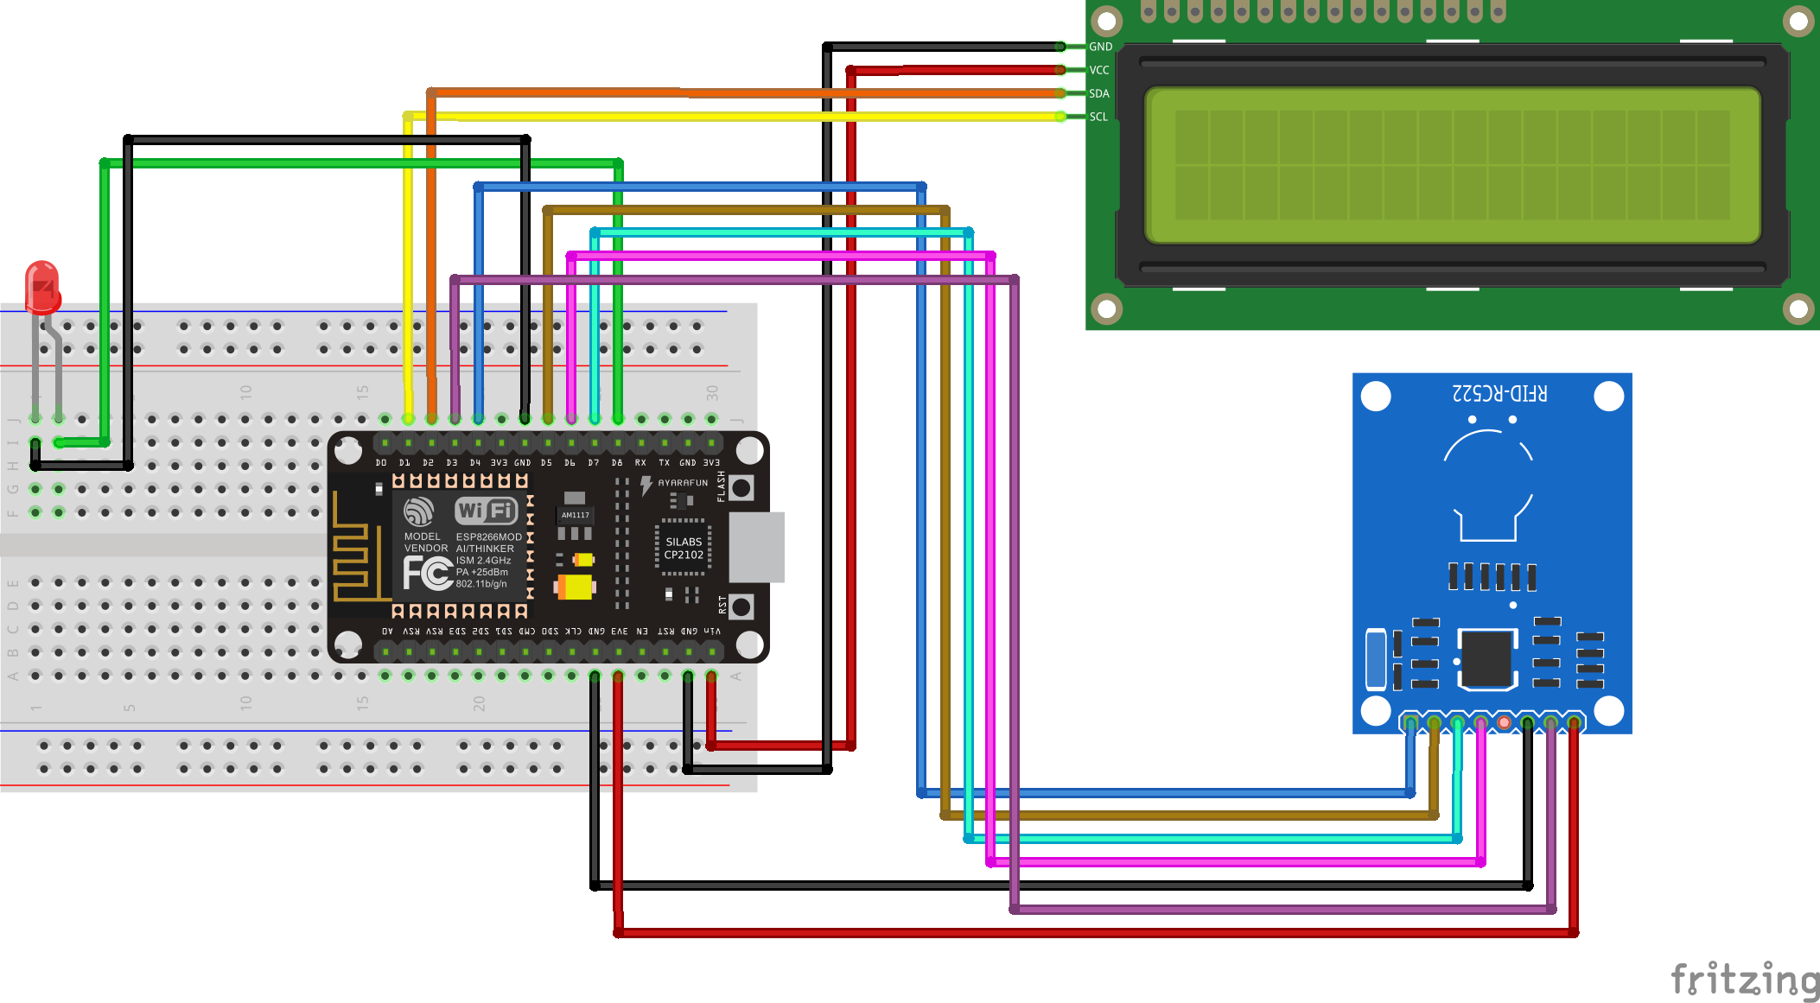
Wiring Diagram
ESP8266 GPIO | LCD I2C 16x2 | MFRC522 | LED
VIN | VCC
3.3V |  | 3.3V
GND | GND | GND | Negative (-)
GPIO-5 (D1) | SCL
GPIO-4 (D2) | SDA
GPIO-15 (D8) |  |  | Positive (+)
GPIO-2 (D4) |  | SDA
GPIO-14 (D5) |  | SCK
GPIO-13 (D7) |  | MOSI
GPIO-12 (D6) |  | MISO
GPIO-0 (D3) |  | RST

